Slide 1

Project management
Viet-Trung Tran
trungtv.github.io
School of Information and Communication Technology

Slide 2
Outline

Slide 3
Building an information system
A project is a planned undertaking with a start and finish, that produces an end result
Should include all the activities needed to design, develop, and launch a new system
Identify
Plan
Organize
monitor

Slide 4
Classification of projects
Successful
completed on time
within budget
meets users’ requirements for functionality
Challenged
either late or over budget
reduced in scope
Failed
cancelled, or
system never used

Slide 5
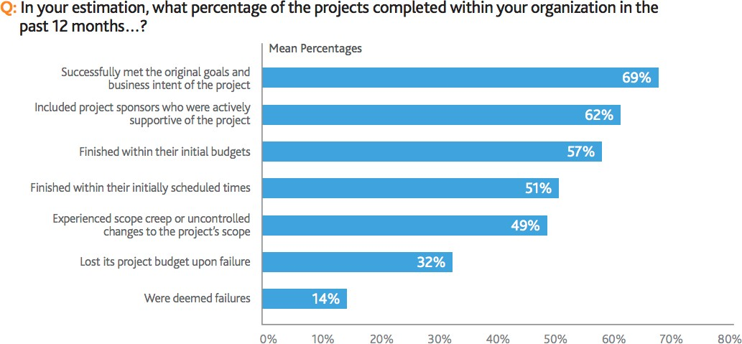
Some facts
Most IT projects are less than successful as measured by
finishing on time
finishing within budget
meeting the need based on the original problem definition
5

Slide 6
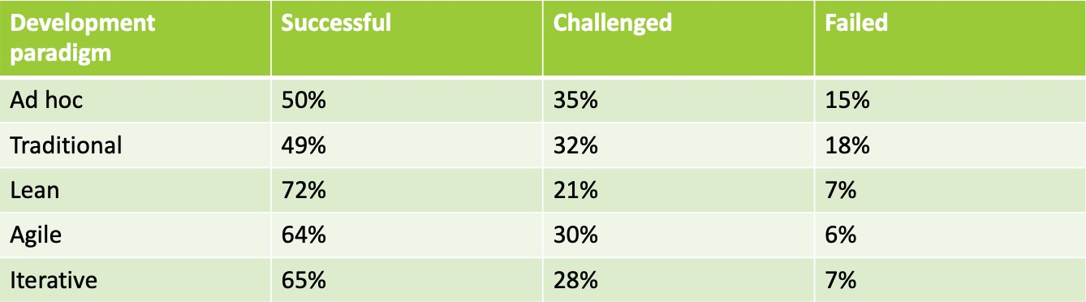
Project success rates
(c) http://www.drdobbs.com/architecture-and-design/the-non-existent-software-crisis-debunki/240165910

Slide 7
Project success factors?
Some primary reasons that projects fail
Undefined project management practices
Poor IT management and procedures
Inadequate executive support for the project
Inexperienced project managers
Unclear business needs and project objectives
Inadequate user involvement
Some reasons that projects succeed:
Clear system requirement definitions
Substantial user involvement
Support from upper management
Thorough and detailed project plans
Realistic work schedules and milestones

Slide 8
Project Management
Project management is organizing and directing other people to achieve a planned result within a predetermined schedule and budget
Small projects are hard to manage
This challenge is multiplied for large, complex projects

Slide 9
Project Manager - Internal roles
manage people and resources
serves as centre-point of the team
develop project schedule
recruiting and training
assigning tasks to teams and team members
assess project risks
monitory and control project deliverables

Slide 10
Project Manager - External roles
Conduct public relations
serves as relay to outside
report project’s status and progress
work directly with client and other stakeholders
identifies resources needs
obtains resources

Slide 11
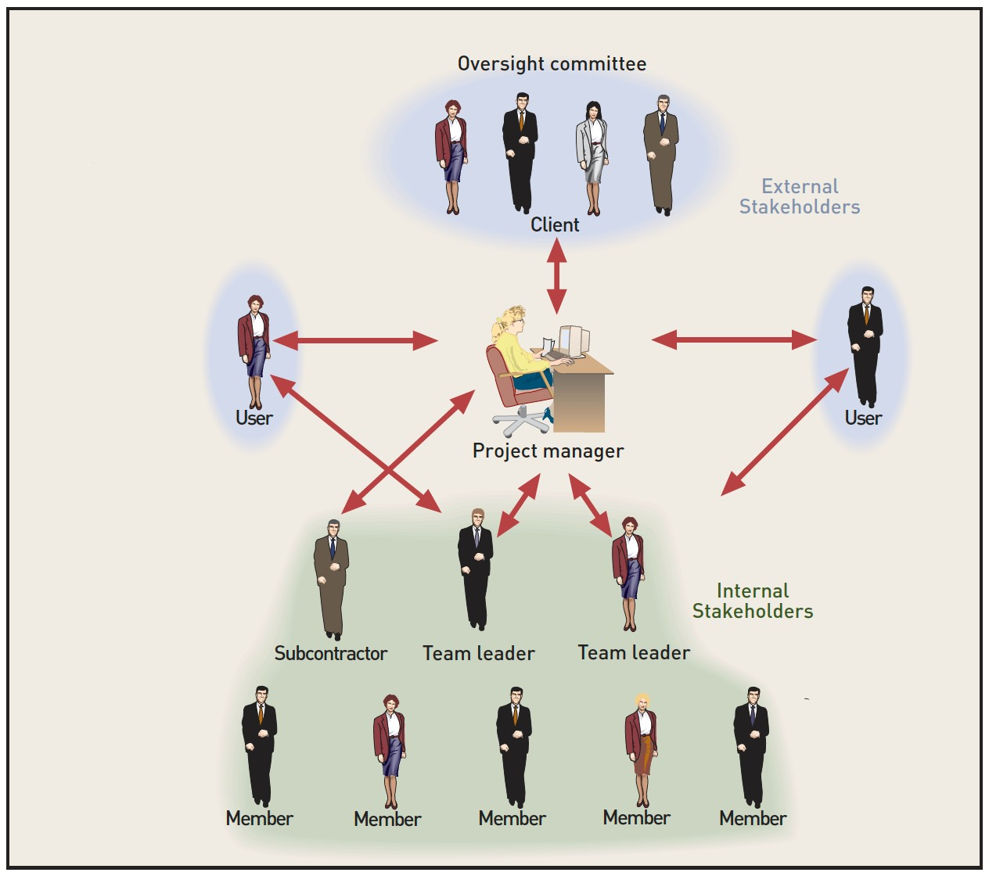

Slide 12
Roles
Project Manager
develops the project schedule
recruits and trains team members
assigns works to teams
assesses project risks
monitors and controls project deliverables and milestones
Team Leaders
facilitates members of their team
looking forward for road blocks
access to resources
facilitate communication

Slide 13
Roles [2]
Developers
responsible for delivering the product, based on the specifications
often involved in developing the specification too
prototyping
QA
verifies the system meets the specs.
should be actively involved in development
Documentation
creates instructional materials
documents changes to the spec (from the user’s perspective)

Slide 14
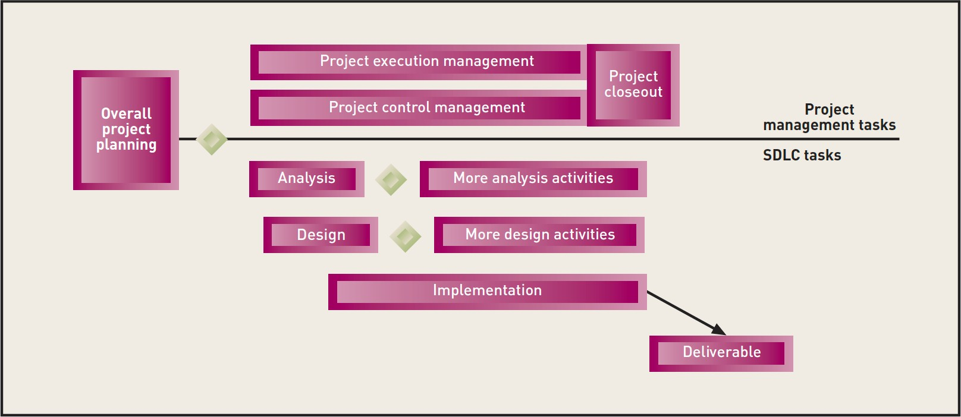
Project management and SDLC tasks for a predictive project
project planning involves both project management and SDLC tasks, because planning for a project requires participation by both the key team members and the project manager

Slide 15
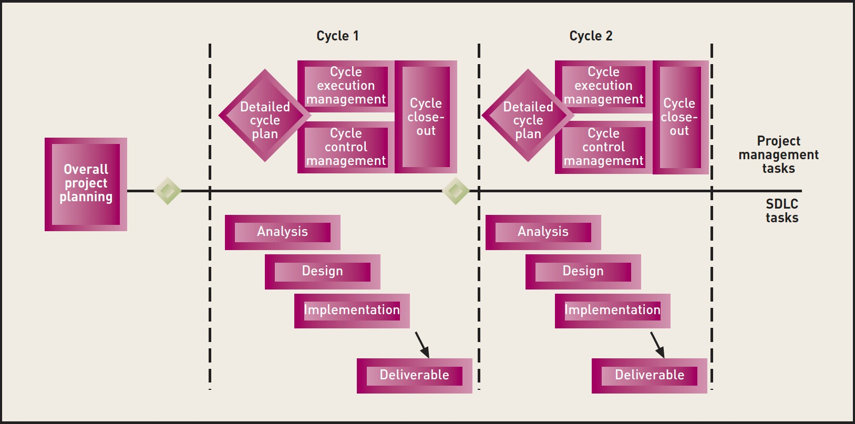
Project management and SDLC tasks for an adaptive project

Slide 16
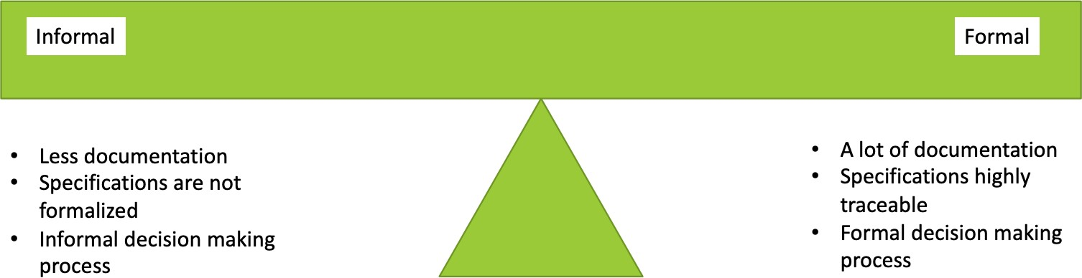
Formality and Ceremony of Projects
What level of formality is right?
how much documentation?
how traceable are the specifications?
how formal is the decision-making process?

Slide 17
Agile Software Development
Agile Software Development is a philosophy of software development that embraces flexibility and agility
Traditional Software Development
Processes and tools
Comprehensive documentation
Contract negotiation
Following a plan
Agile Development
Individuals and Interactions
Working Software
Customer Collaboration
Responding to change

Slide 18
Agile’s 12 principles
Customer satisfaction by early and continuous delivery of valuable software
Welcome changing requirements, even in late development
Working software is delivered frequently (weeks rather than months)
Close, daily cooperation between business people and developers
Projects are built around motivated individuals, who should be trusted
Face-to-face conversation is the best form of communication (co-location)
Working software is the primary measure of progress
Sustainable development, able to maintain a constant pace
Continuous attention to technical excellence and good design
Simplicity—the art of maximizing the amount of work not done—is essential
Best architectures, requirements, and designs emerge from self-organizing teams
Regularly, the team reflects on how to become more effective, and adjusts accordingly

Slide 19
Agile Development
Small, quick increments
1-4 weeks
Minimal up-front planning and design
All functions take place at each iteration
planning, analysis, design, coding, unit testing, acceptance testing
All teams include a customer representative Daily stand-up (or scrum)
At end of each iteration product is demo’d to stakeholders

Slide 20
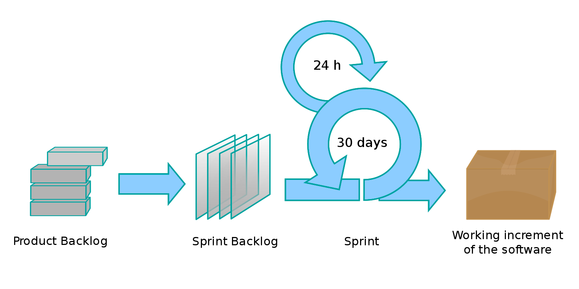
Scrum
for teams of 3-9 developers
2 week cycles (sprints)
daily meeting
deliverable software at end of each cycle

Slide 21
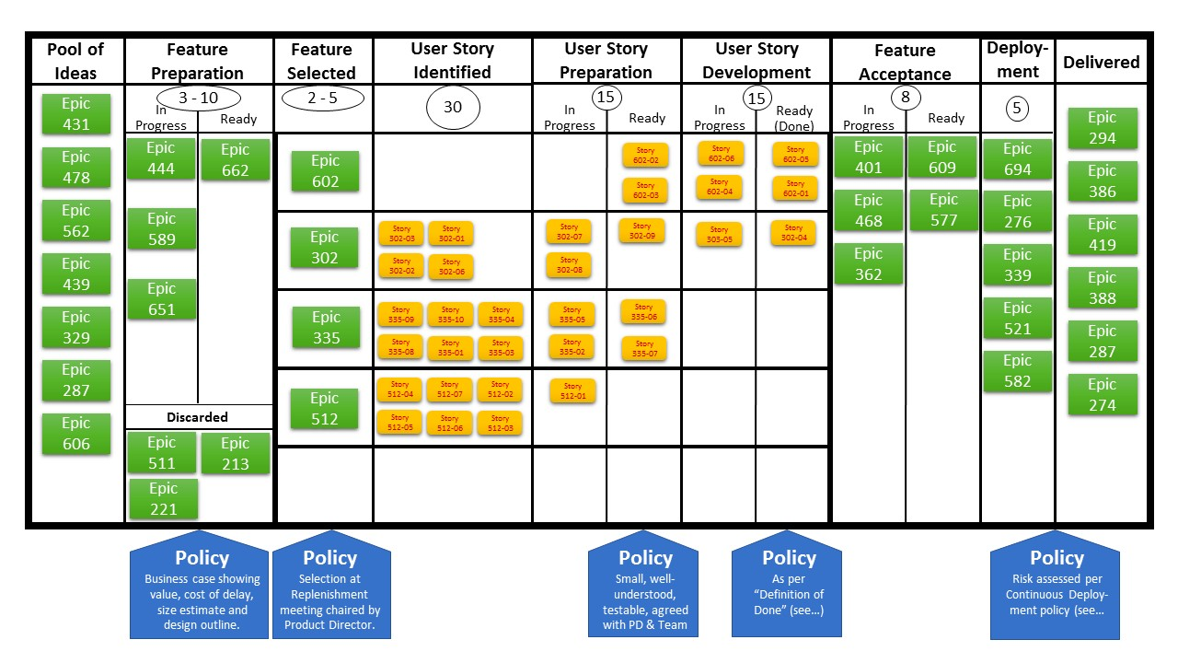
Kanban
visualization technique
helps spot bottlenecks
members pull work when they have capacity

Slide 22
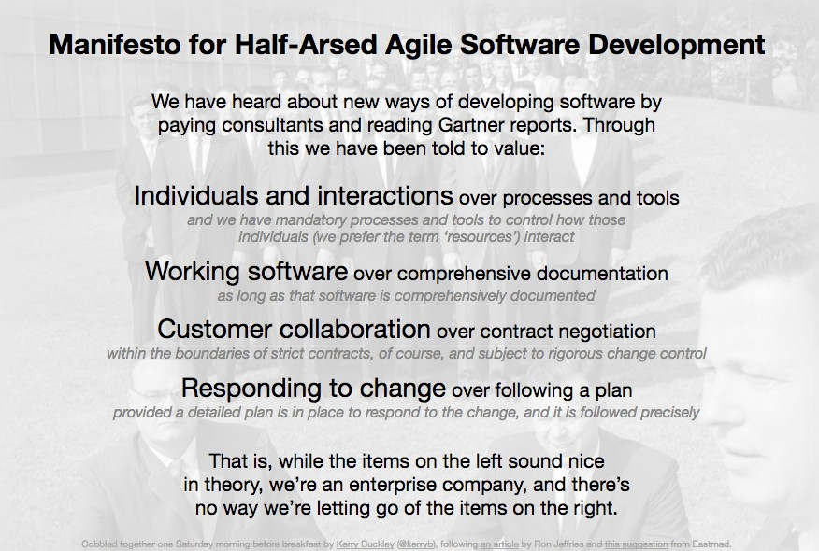

Slide 23

Thank you for your attention! Q&A

